Slide 1

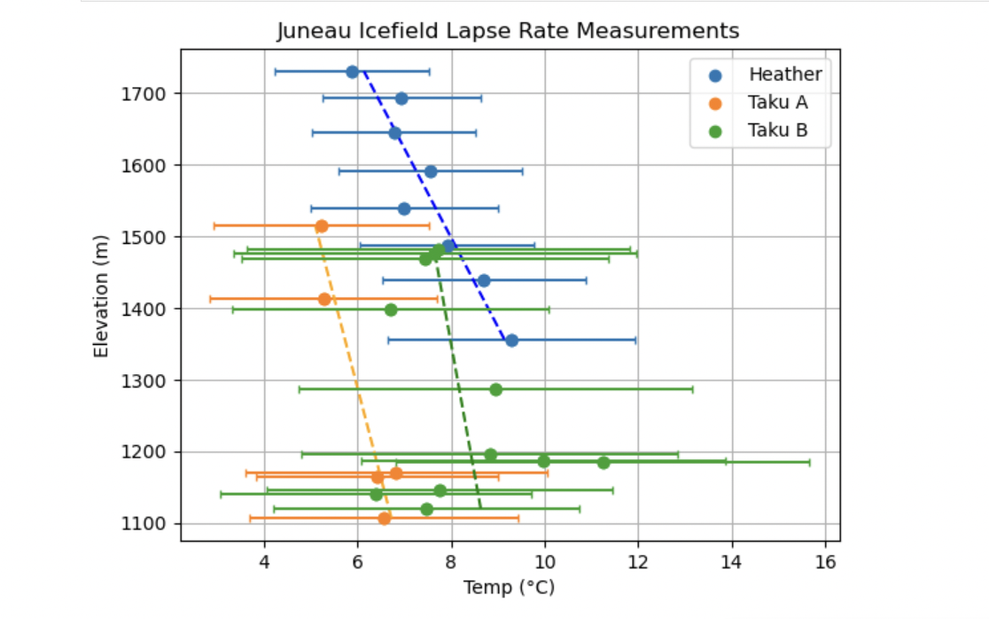
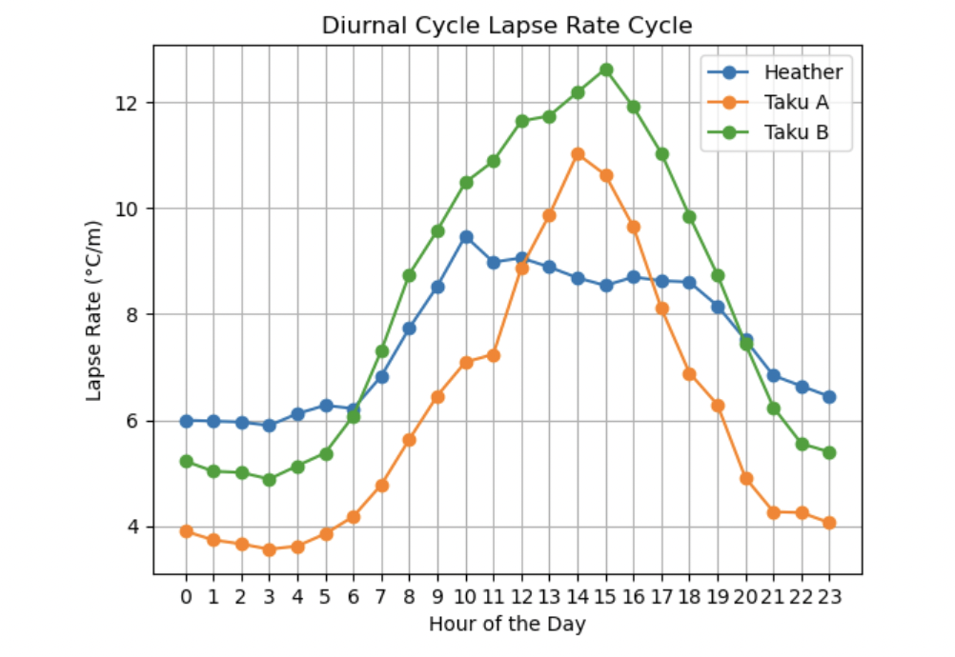
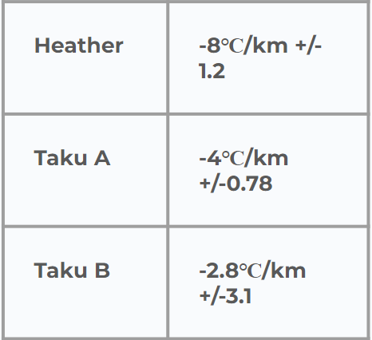
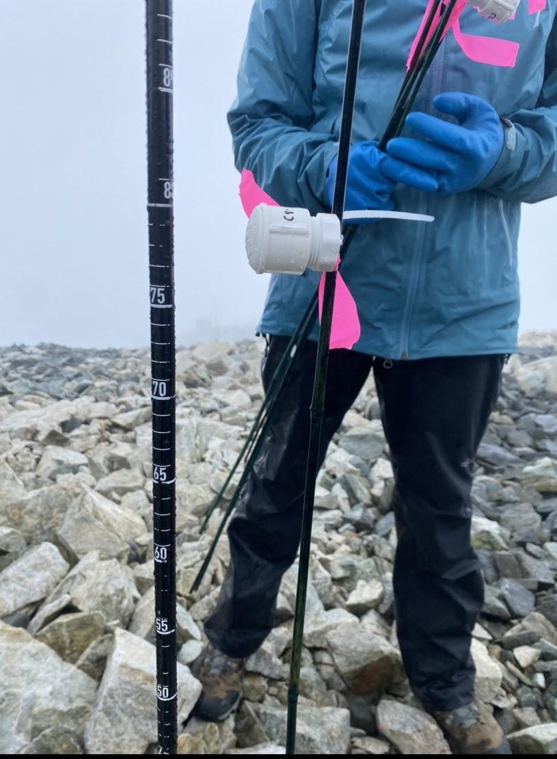
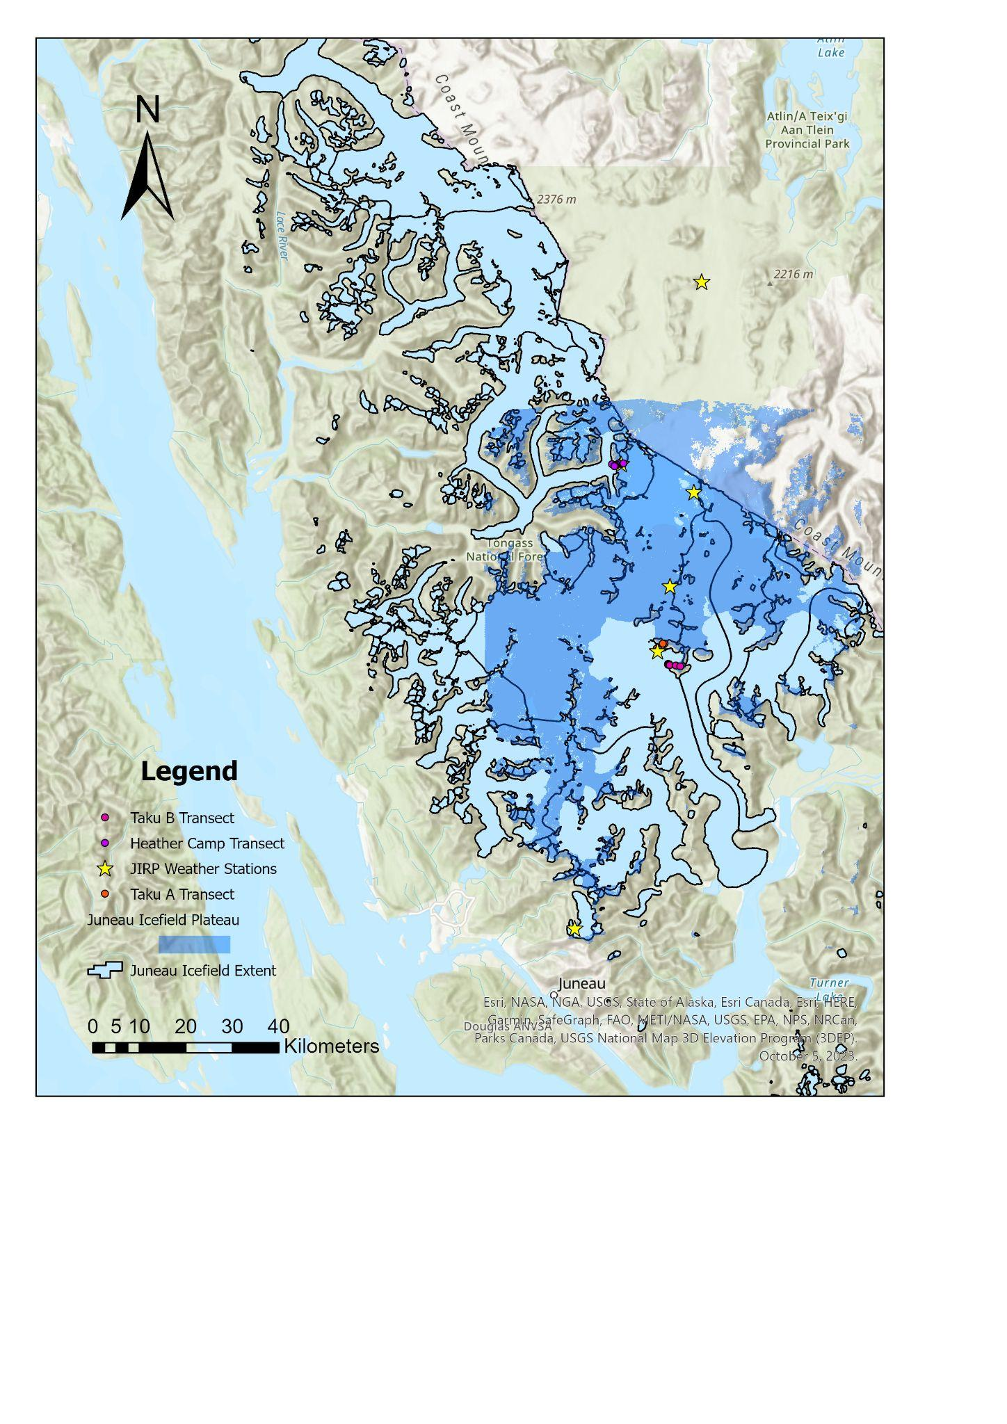
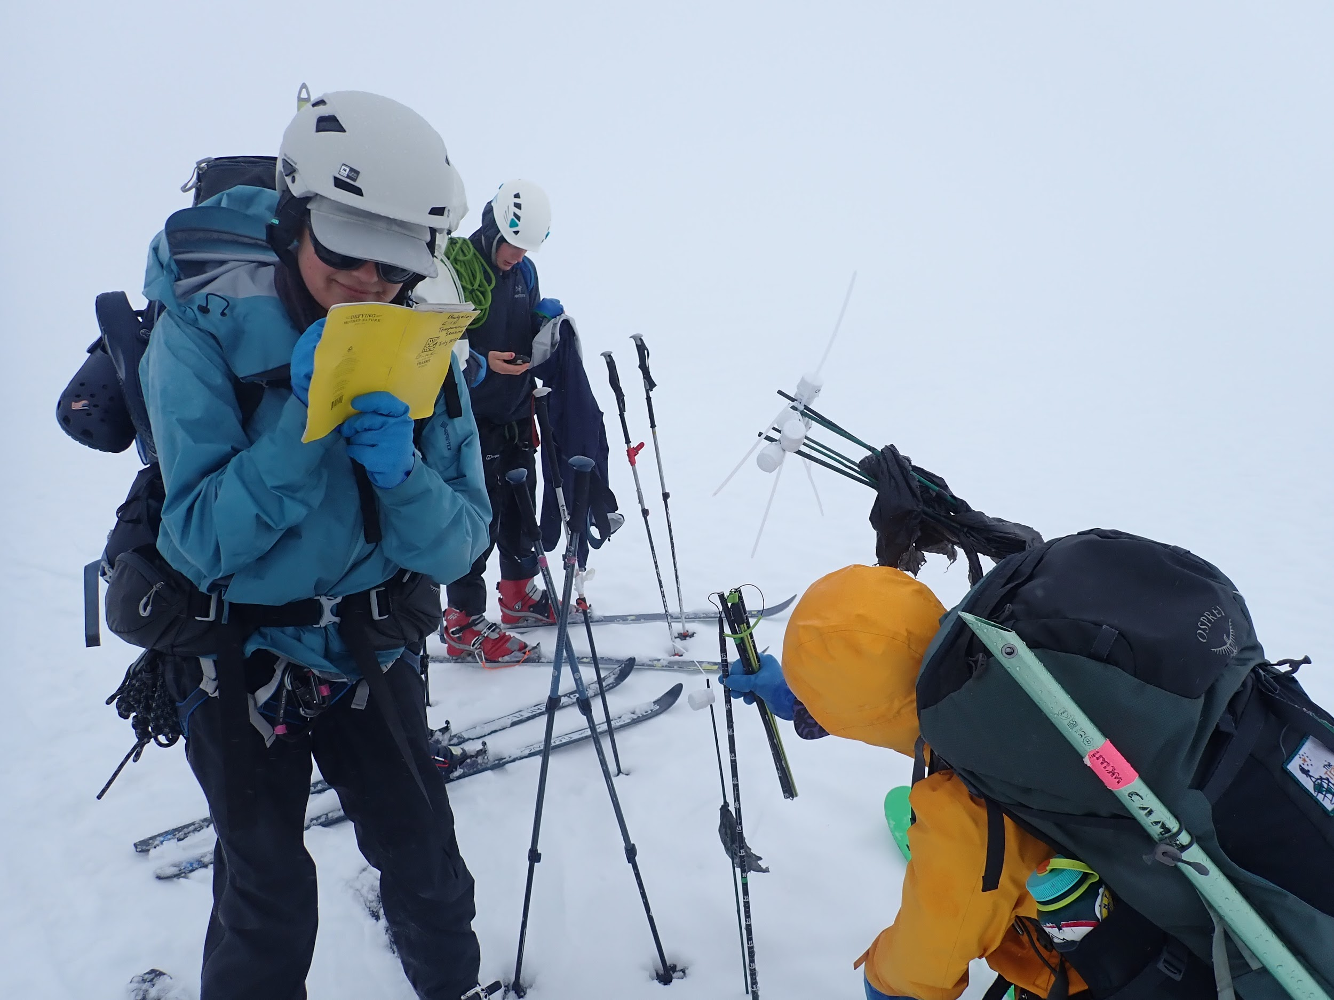
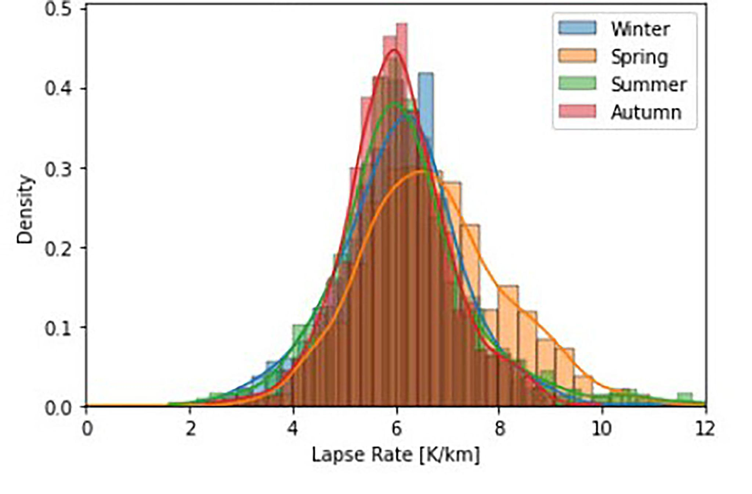
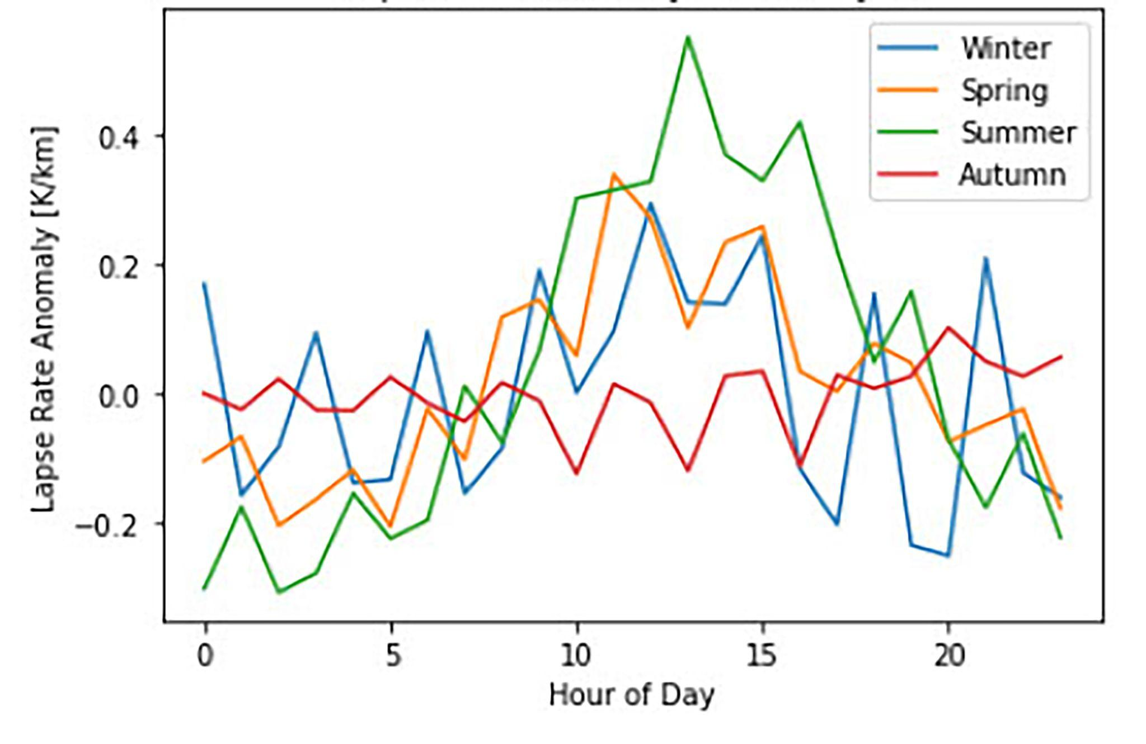
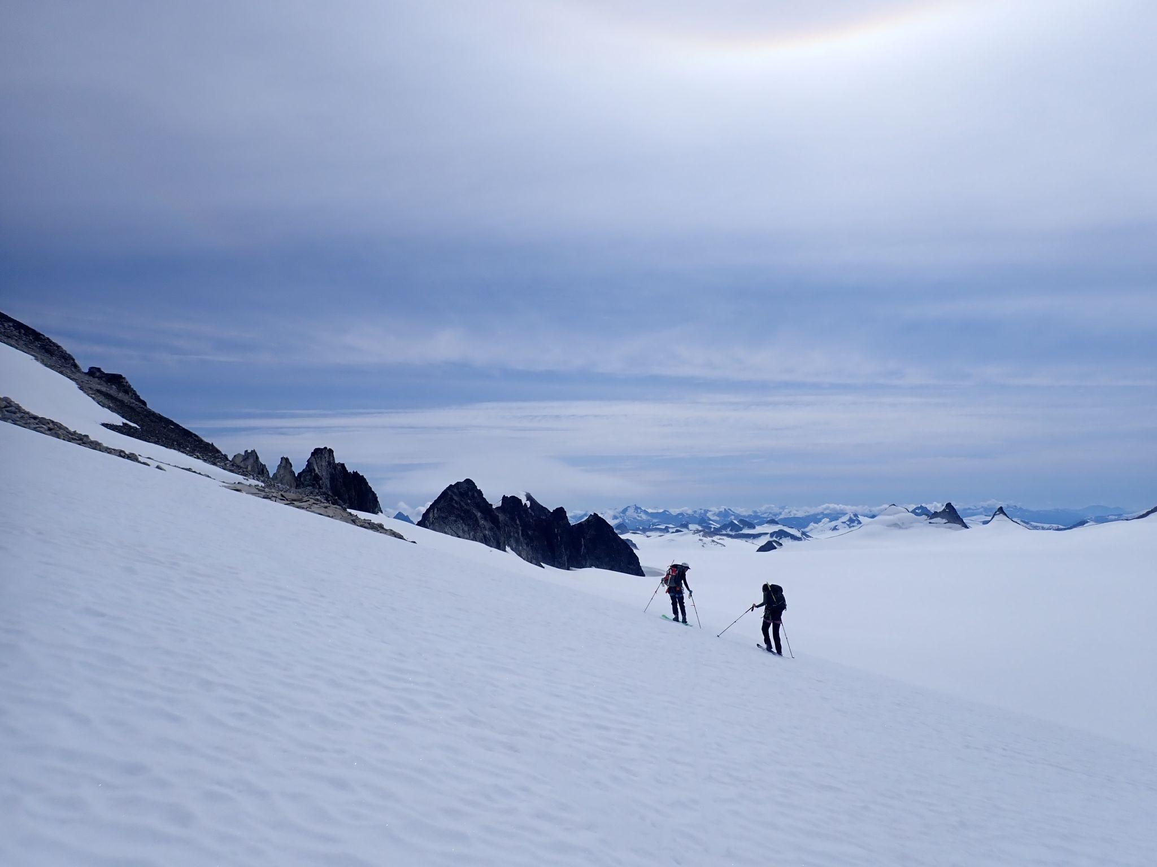
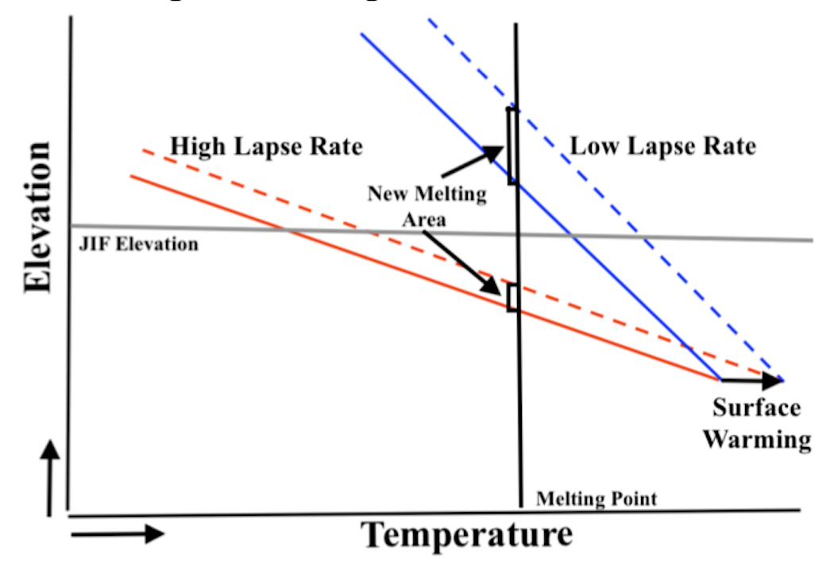
Multiple Scales of Lapse Rate Variability on the Juneau Icefield
Adelle Welch (Bates College), Julius Mex (Ecole Normale Supérieure Paris), Leah Fleming (University of New Hampshire), Lia Salomon (Carleton College), Sophia Ludtke (Harvard College), Daniel Otto (University of Washington), Mira Berdahl (University of Washington)
SUMMARY:
RESULTS:
METHODOLOGY:
• iButton temperature sensors were used to measure in situ air temperature on the Juneau Icefield. This and data from Juneau Icefield Research Program (JIRP) weather stations was used to calculate lapse rates. • Rates vary from -2.8℃/km to -8℃/km and exhibit a distinct diurnal cycle and seasonal variability. These represent more variability than suggested by the long-term whole-icefield lapse rate calculated from weather stations like the Juneau Airport. • Constraining variability in diurnal and seasonal lapse rates and understanding the effect of local factors are important goals for future mass-balance assessments on the Juneau Icefield
Data Sources:
A) iButton temperature sensors (Fig. 2)
B) Historical weather station data (1998-2018)
→ calculated a linear regression to determine lapse rate (℃/km)
Figure 4a
Figure 3a
Figure 2b
Figure 4. a) Juneau Icefield transect lapse rate measurements b) Diurnal cycle of lapse rates on Juneau Icefield transects
BACKGROUND:
Figure 2c
•Near surface lapse rates, used to calculate high-elevation temperatures, are often assigned a generic value (e.g. -5℃/km) but are known to vary depending on a number of conditions • Linear lapse rates extrapolated from local data (e.g. Juneau Airport data) might neglect local factors such as slope, aspect, and surface properties
Figure 2d
Figure 2:Map of the Juneau Icefield (Fig 2a) showing the Taku A (Fig 2b), Taku b (Fig 2c) and Heather iButton temperature sensor transects deployed along the icefield (Fig 2d) July 2023.
Steeper lapse rate = greater vulnerability to glacial melt
• Variations include steeper and shallower lapse rates (Fig. 4 and Fig. 5) than used in previous Juneau Icefield mass balance studies (McNeil et al, 2020. O’Neel et al, 2019)
• Seasonal variations depend on slope, aspect, snow coverage, and local climate that is difficult to account for without high-resolution temperature data.
Figure 5. a) Distribution of seasonal dependency of daily lapse rates on the Juneau Icefield from historical weather data b) Seasonal dependency of daily lapse rate anomalies on the Juneau Icefield from historical weather station data
ACKNOWLEDGEMENTS:
Special thanks to Mira Berdahl and Daniel Otto for their support, guidance and feedback throughout this project, to Bates and Carlton Colleges and Harvard University for AGU travel support, to Jessica Badgeley for use of the iButton sensors, and to the Taku River Tlingit and Tagish people on whose unceded land this research was conducted.
Figure 1: Spatially and temporally specific lapse rates are important in projecting future ice field sensitivity ⇒ steeper lapse rate exposes greater glacial area to melt as global temperatures warm
•McNeil C et al. Explaining mass balance and retreat dichotomies at Taku and Lemon Creek Glaciers, Alaska. J. Glaciol. 66 (258), 530–542. (2020).
•O’Neel S. et al. Reanalysis of the US Geological Survey Benchmark Glaciers: long-term insight into climate forcing of glacier mass balance. J. Glaciol. 65, 850–866. (2019).
Notes:
Updated graphs

